Slide 1
English Class #3
November 23, 2020

Slide 2
Review: Do vs. Does
Do/Does | Subject | Verb | The rest of the sentence
Do | I / you / we / they | Like, have, buy | Cereal for breakfast
Does | He / she / it

Slide 3
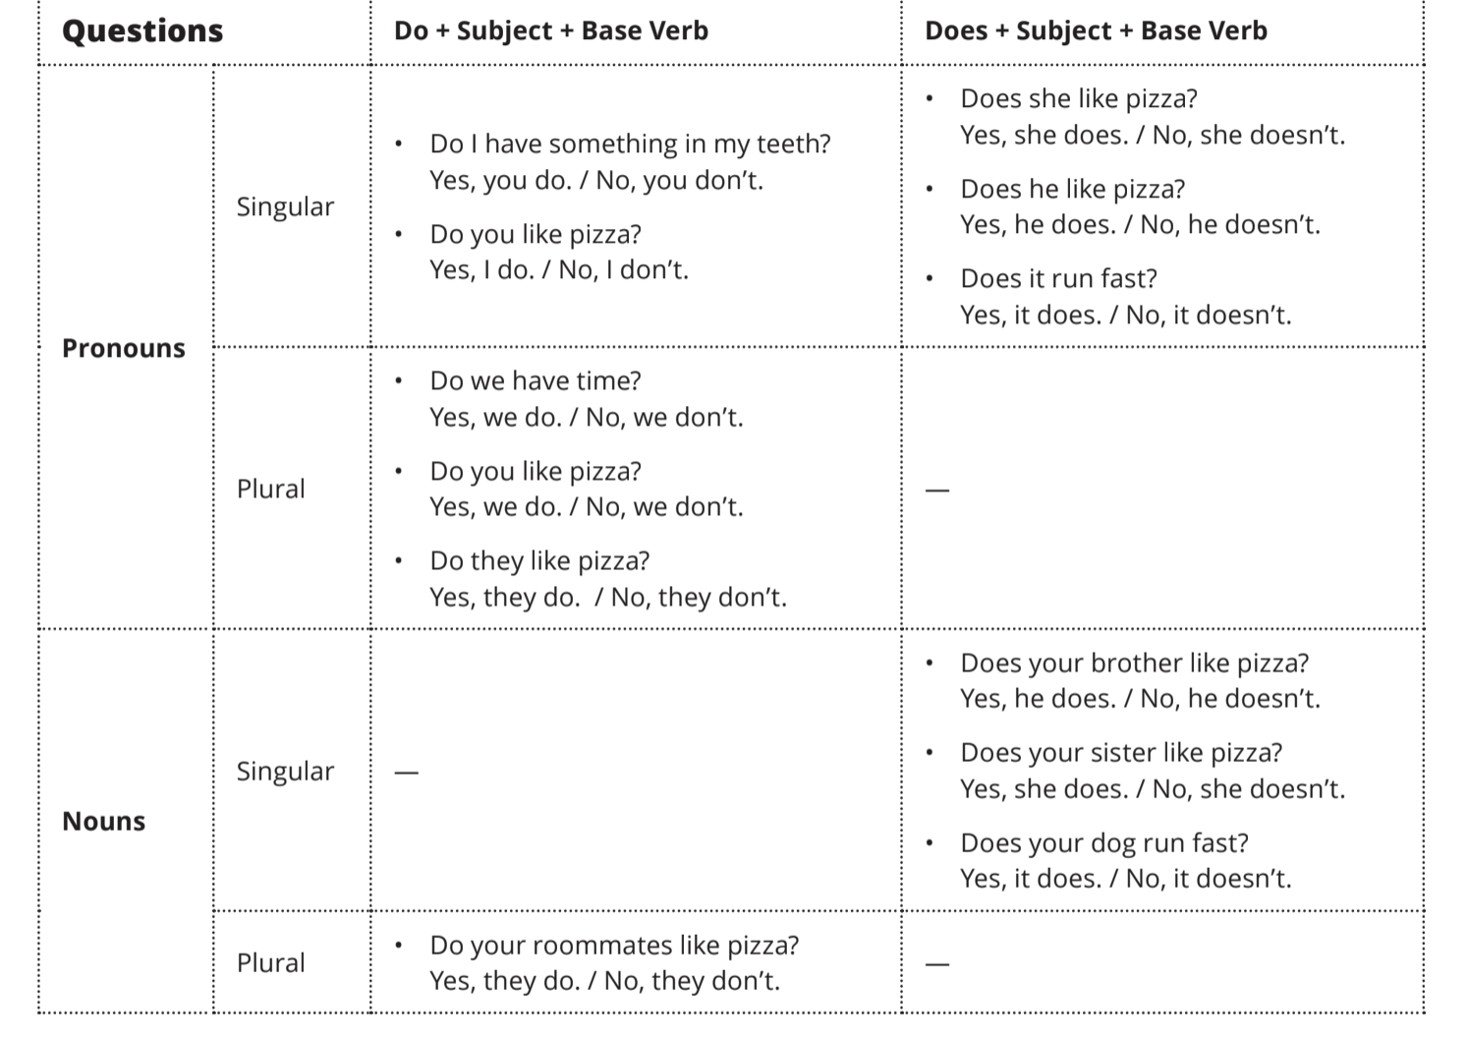

Slide 4
Answers with Do and Does:
Sample Questions | Affirmative | Negative
Do you speak English? | Yes, I do | No, I don’t (do not)
Do I need a dictionary? | Yes, you do | No, you don’t
Do you both speak English? | Yes, we do | No, we don’t
Do they speak English? | Yes, they do | No, they don’t
Does he speak English? | Yes, he does | No, he doesn’t (does not)
Does she speak English? | Yes, she does | No, she doesn’t
Does it have four legs? | Yes, it does | No, it doesn’t

Slide 5
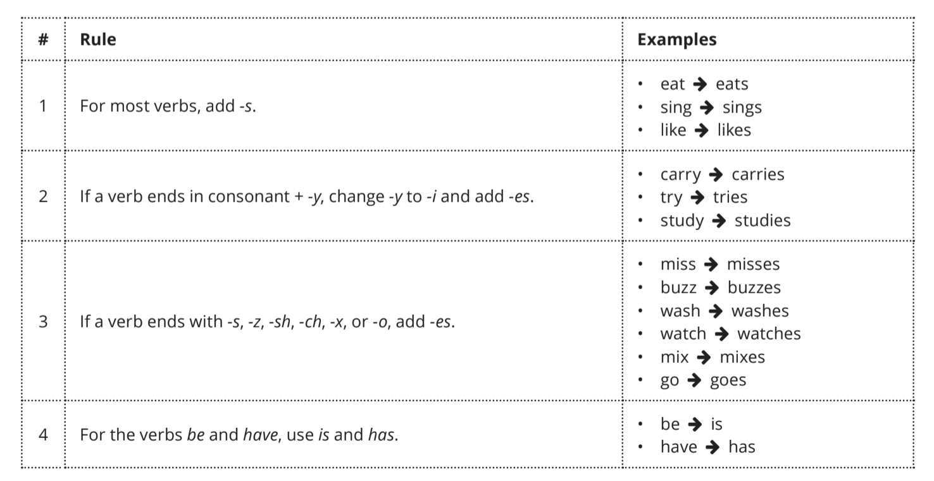
Third Person Singular (He/she/it)

Slide 6
Irregular Verbs:
To be : I am, You are, He is/She is/It is, We are, They are
To do I do, You do, He/She/It does, We do, They do
To have I have, You have, He/She/It has, We have, They have
To say I say, You say, He/She/It says, We say, They say
To go I go, You go, He/She/It goes, We go, They go

Slide 7
Other Important Verbs:
To want = querer … I want to work.
To love = amar … I love my mother.
To like = gostar … I like sports.
To use = usar … I use a computer at school.
To watch = assistir … I watch TV at home.
To give = dar … I give my brother a banana.
To work = trabalhar … I work every day.
To need = precisar … I need water.
To make = fazer … I make a cake.

Slide 8
Important Verbs Continued:
To sit = sentar… Sit down!
To take = tomar… My brother takes my money.
To understand = entender… Do you understand?
To think = pensar… I think soccer is fun.
To talk = falar… Sarah talks to John.
To read = ler… Do you like to read?
To sleep = dormir… My son sleeps a lot.
To eat = comer… When do you want to eat?
To drink = beber… I like to drink wine.

